Slide 1
CIS8695: Managing Big Data Analytics
Nasim Mousavi
Assistant Professor
J. Mack Robinson College of Business
Georgia State University
nmousavi@gsu.edu

Slide 2
Linear Regression

Slide 3
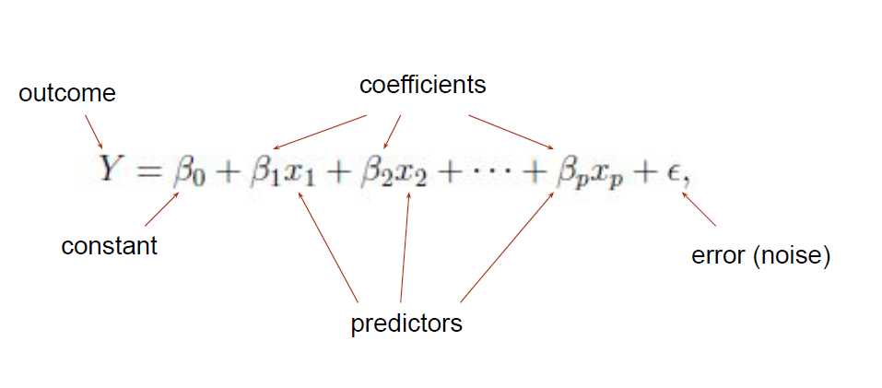
Regression Analysis
A statistical technique to fit a relationship between a numerical outcome variable and a set of predictors
Linear regression assumes the following relationship between predictors and target variable

Slide 4
Regression: Explanatory Modeling
Quantifying the average effect of independent variables on an outcome variable
Fit the data well and understand the effect of explanatory variables
Use entire dataset for analysis, no train/test separation
Model performance is measured by
“goodness-of-fit”, R², residual analysis, p-values

Slide 5
Regression: Predictive Modeling
No interest in estimating coefficients
The focus is on predicting the outcome value for new records
Optimize predictive accuracy
Train model on training data, assess performance on validation (hold-out) data
Model performance is measured by predictive accuracy
Total sum of squared errors (SSE), Mean squared error (MSE), Root mean squared error (RMSE)

Slide 6

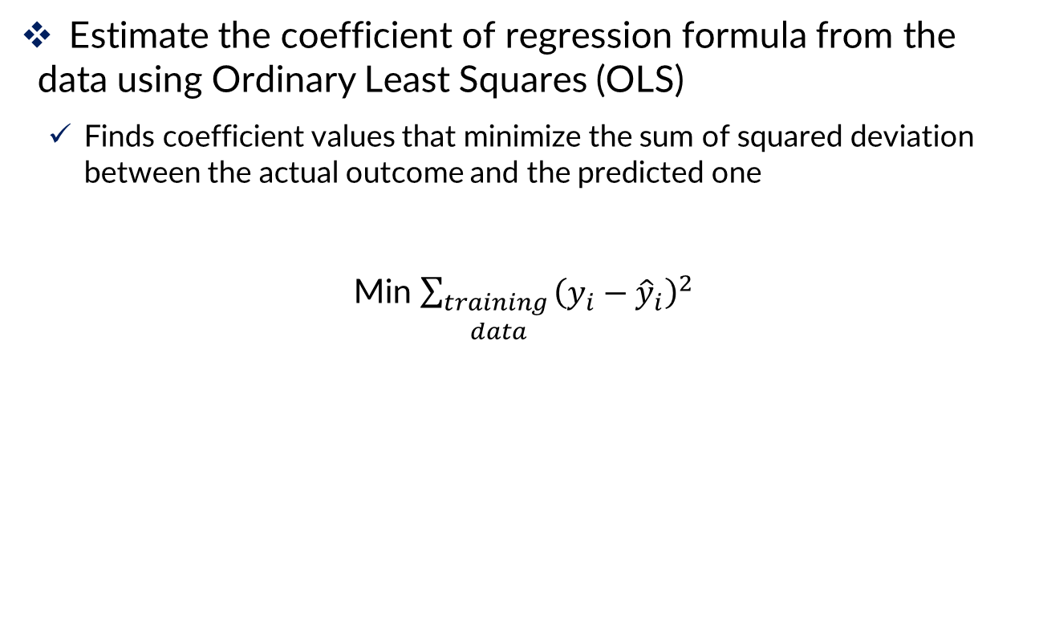
Linear Regression: Basic Idea
Estimate the coefficient of regression formula from the data using Ordinary Least Squares (OLS)
Finds coefficient values that minimize the sum of squared deviation between the actual outcome and the predicted one
Min $\sum_{\begin{aligned}training \\ data\end{aligned}}{{\left(y_{i}−{\hat{y}}_{i}\right)}^{2}}$

Slide 7
Example

Slide 8
Problem: Prices of Toyota Corolla
A large Toyota car dealership offers purchasers of new Toyota cars the option to buy their used car as part of a trade-in
Pay high prices for used Toyota Corolla cars for purchasers of a new car
The dealer then sells the used cars for a small profit
To ensure a reasonable profit, the dealer needs to predict the price for the used cars
Data were collected on all previous sales of used Toyota Corollas

Slide 9
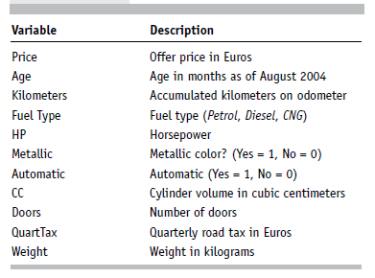
Problem: Prices of Toyota Corolla
Data: 1000 used Toyota Corollas, with their specification information

Slide 10
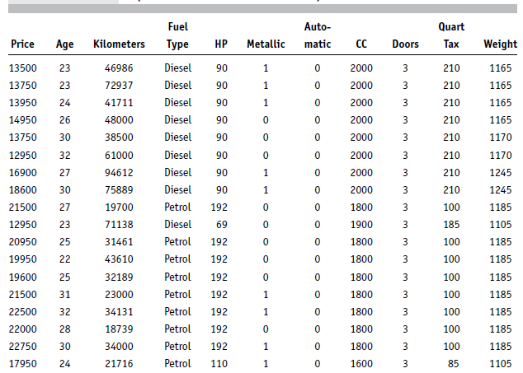
Problem: Prices of Toyota Corolla

Slide 11
Data Preprocessing
Fuel type is categorical, must be transformed into binary variables
Has three categories, so use two dummies:
Fuel_Type_Diesel (0/1), Fuel_Type_CNG (0/1)
No dummy needed for “Petrol” (reference category)
Data partition (training 60% validation 40%)

Slide 12
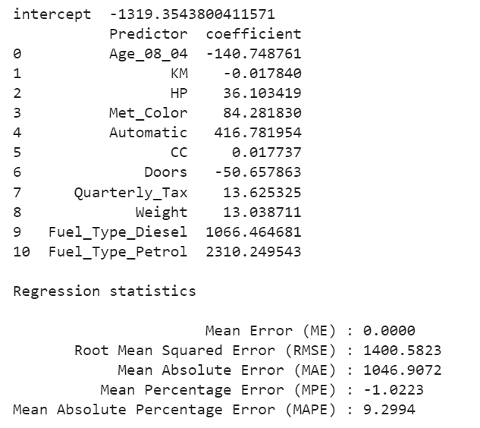
The Fitted Regression Model on Training

Slide 13
The Fitted Regression Model on Training
What does the coefficient tell us? (like weight)
As the value of the Weight increases in one unit, holding others constant, the mean of the dependent variable increases by 13 units

Slide 14
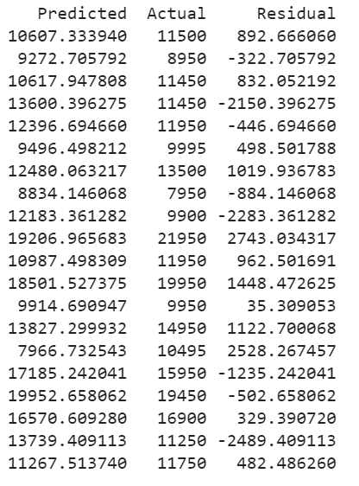
Predictions for the Validation Data
Predicted price computed using regression coefficients
Residuals = difference between actual and predicted prices

Slide 15
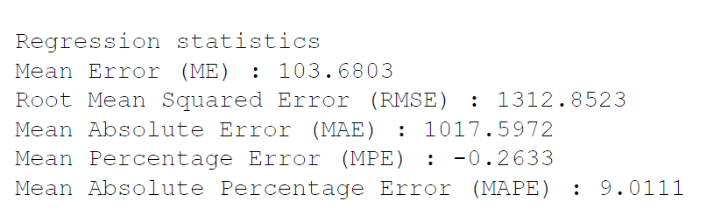
How Well did the Model Do With the Validation Data?

Slide 16
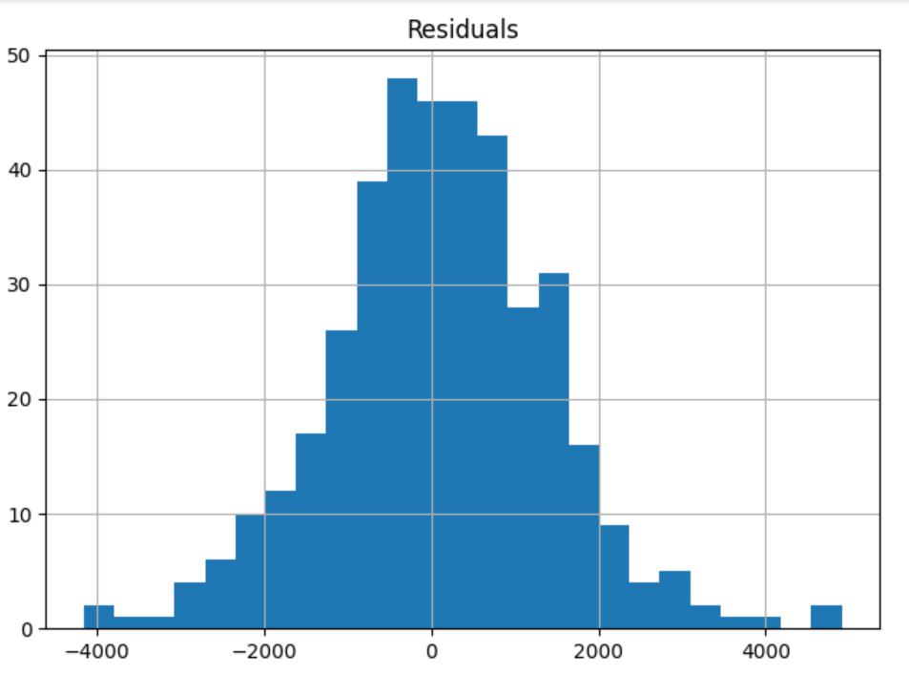
How Well did the Model Do With the Validation Data?
Most of the errors are between +2000 & -2000
Large positive residuals show under-predictions
Should be taken account for pricing the cars

Slide 17
Variable Selection

Slide 18
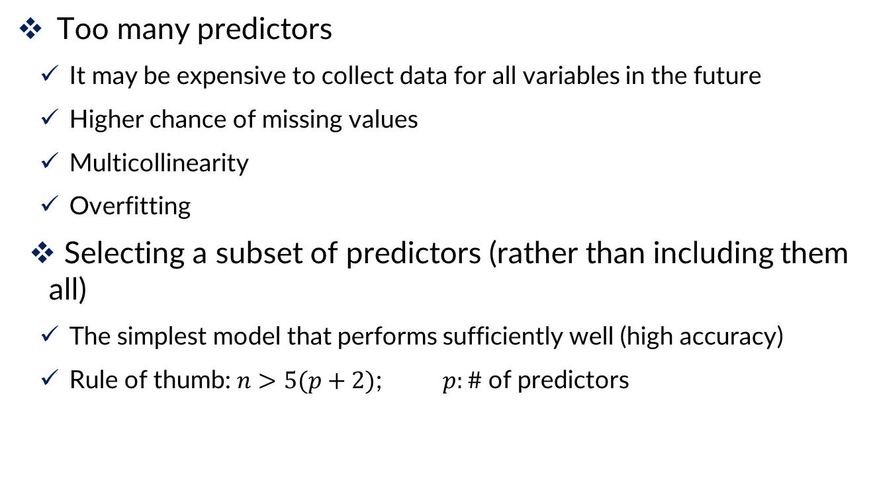
Why Variable Selection?
Too many predictors
It may be expensive to collect data for all variables in the future
Higher chance of missing values
Multicollinearity
Overfitting
Selecting a subset of predictors (rather than including them all)
The simplest model that performs sufficiently well (high accuracy)
Rule of thumb: $n>5(p+2)$; $p:\#$of predictors

Slide 19
How to Select Variables? Basic Methods
The first step is using domain knowledge to select the relevant predictors
Summary statistics and graphs
Correlation tables, missing value counts
To detect variables highly correlated or with high level of missing values

Slide 20
How to Select Variables? Exhaustive Search
All possible subsets of predictors assessed (single, pairs, triplets, etc.)
Select a subset that not too simplistic (underfit) and not overly complex (overfit)

Slide 21

Criterion to Select the best Subset
Judge by “adjusted R²”
$R^{2}$: Proportion of explained variability in the model
$n$= Number of predictors
$p=$Penalty on the number of predictors
Models with higher adjusted R² is better

Slide 22
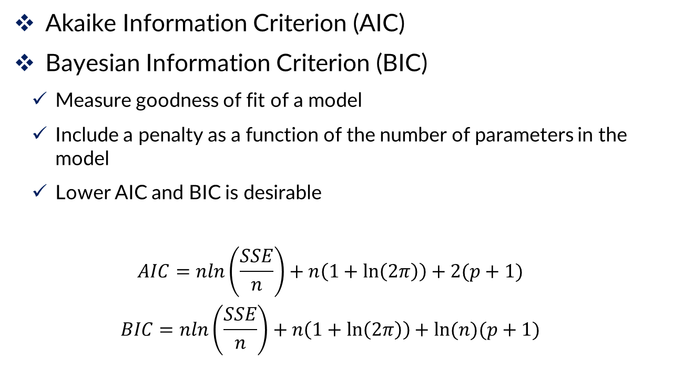
Criterion to Select the best Subset
Akaike Information Criterion (AIC)
Bayesian Information Criterion (BIC)
Measure goodness of fit of a model
Include a penalty as a function of the number of parameters in the model
Lower AIC and BIC is desirable
$$AIC=nln\left(\frac{SSE}{n}\right)+n\left(1+\ln\left(2π\right)\right)+2(p+1)$$
$$BIC=nln\left(\frac{SSE}{n}\right)+n\left(1+\ln\left(2π\right)\right)+ln⁡(n)(p+1)$$

Slide 23
How to Select Variables? Model-Based
Iterative search through the space of all possible regression models
Deliver one best subset of predictors
Popular variable selection algorithms
Forward Selection
Backward Elimination
Stepwise Regression

Slide 24
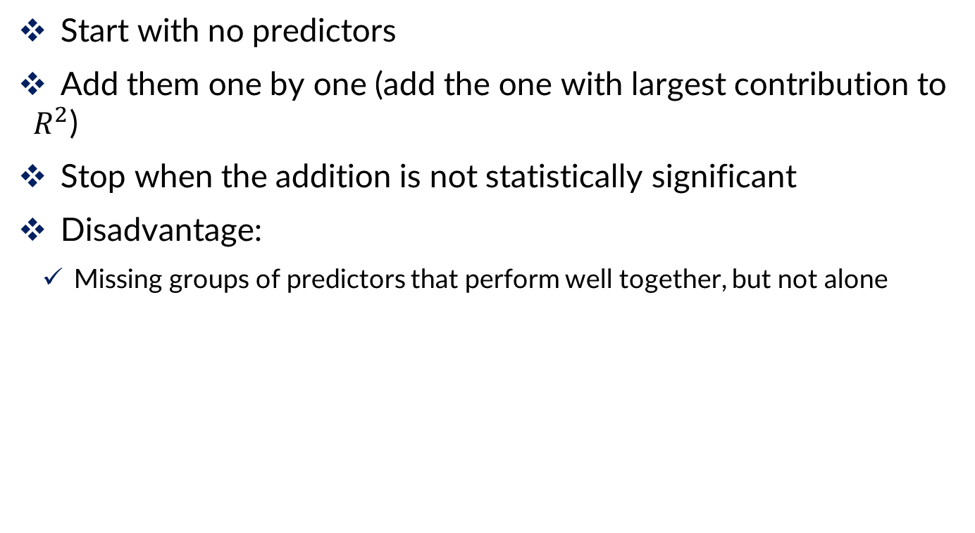
Forward Selection
Start with no predictors
Add them one by one (add the one with largest contribution to $R^{2}$)
Stop when the addition is not statistically significant
Disadvantage:
Missing groups of predictors that perform well together, but not alone

Slide 25
Backward Elimination
Start with all predictors
Successively eliminate least useful predictors one by one
Stop when all remaining predictors have statistically significant contribution
Disadvantage:
Computing the initial model with all predictors can be time-consuming & unstable

Slide 26
Stepwise Regression
Combination of forward selection and backward elimination
Like forward selection
Except at each step, also consider dropping non-significant predictors

Slide 27
Next step
Subset selection methods give candidate models that might be “good models”
Do not guarantee that “best” model is indeed best
Also, “best” model can still have insufficient predictive accuracy
Must run the candidates and assess predictive accuracy

Slide 28
Regularization (Shrinkage)
Alternative to subset selection
Rather than binary decisions on including variables, penalize coefficient magnitudes
This has the effect of “shrinking” coefficients, and reducing variance
Predictors with coefficients that shrink to zero are effectively dropped
Variance reduction improves prediction performance
In other words, this technique discourages learning a more complex or flexible model, to avoid the risk of overfitting

Slide 29
Regularization (Shrinkage)
Using a penalty
Ridge Regression: the normalization term is the sum of the squared weights (L2-norm)
Lasso: the normalization term is the sum of the absolute values of weights (L1-norm)
Predictors need to standardized to have the same scale

Slide 30

Ridge Regression
Linear regression minimizes Residual Sum of Squares (RSS)
The coefficients are chosen, such that they minimize this
This will adjust the coefficients based on your training data
If there is noise in the training data, then the estimated coefficients won’t generalize well to the future data
This is where regularization comes in and shrinks or regularizes these learned estimates towards zero

Slide 31
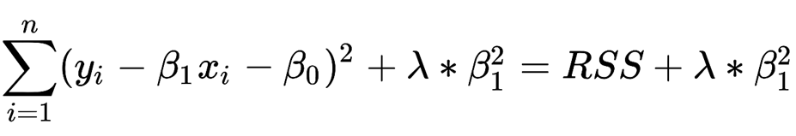
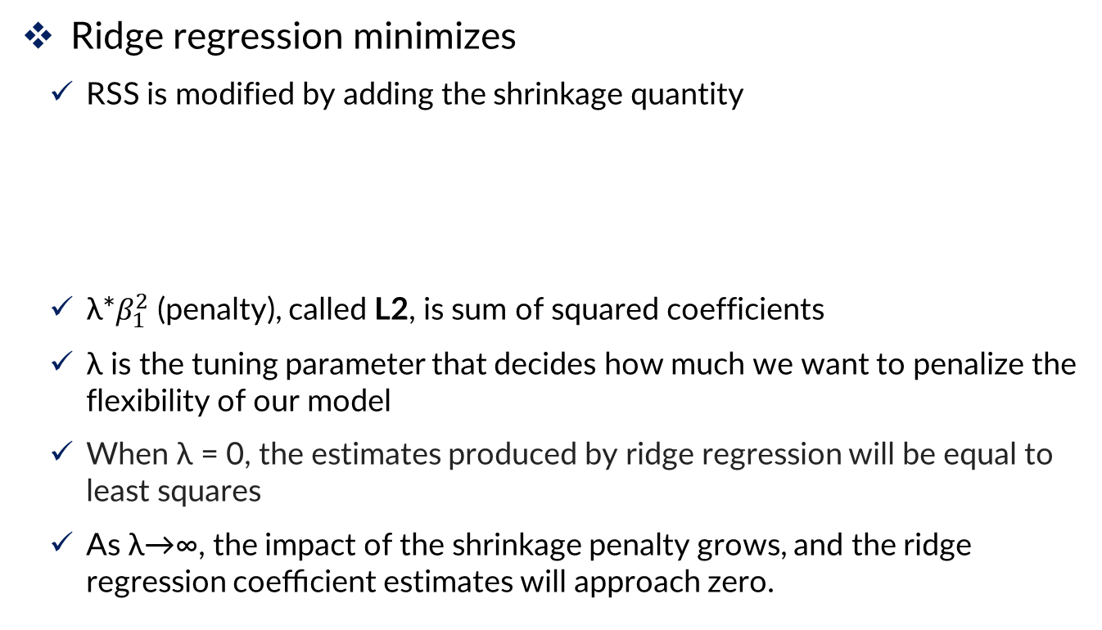
Ridge Regression
Ridge regression minimizes
RSS is modified by adding the shrinkage quantity
λ*$β_{1}^{2}$ (penalty), called L2, is sum of squared coefficients
λ is the tuning parameter that decides how much we want to penalize the flexibility of our model
When λ = 0, the estimates produced by ridge regression will be equal to least squares
As λ→∞, the impact of the shrinkage penalty grows, and the ridge regression coeﬃcient estimates will approach zero.

Slide 32
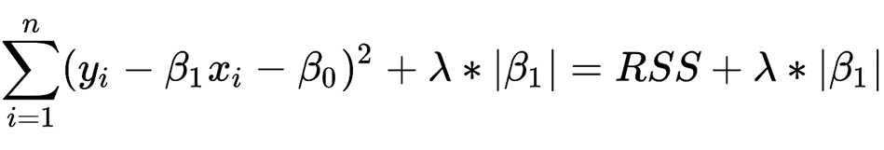
Lasso
Ridge regression minimizes:
Lasso regression minimizes:
The term λ|β1| is a shrinkage penalty, L1, which minimizing the sum of the absolute differences between the target value and the estimated values

Slide 33
Summary
Linear regression models are very popular tools, not only for
explanatory modeling, but also for prediction
A good predictive model has high predictive accuracy (to a useful practical level)
Predictive models are fit to training data, and predictive accuracy is evaluated on a separate validation data set
Removing redundant predictors is key to achieving predictive accuracy and robustness
Subset selection methods help find “good” candidate models. These should then be run and assessed.

Slide 34


